Slide 1
NeoEd Onboard Portal
New Employee Instruction Guide

Slide 2
NEOGOV
Onboard Portal
System that Wallace Community College uses to collect information from new employees.
NEOED Onboard provides useful information about virtual orientation session, orientation resources, a checklist of forms to complete, and helpful links and contact information for you to reference.

Slide 3
Using Your NEOED Account
STEP 1
Activate Your Account
STEP 2
Login to Your Account
STEP 3
View Your Onboarding Information
STEP 4
Complete Your Onboarding Checklist

Slide 4
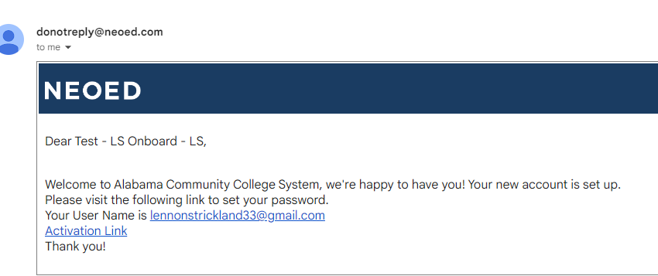
STEP 1 | Activate Your Account
New employees will receive an activation email from donotreply@neoed.com to setup their NEOED Onboard account
The email will be sent the employee’s
personal email address
The employee must click activation link to set their password (please note it can be the same as their current application password)
After setting a password, the employee can access their NEOED account

Slide 5
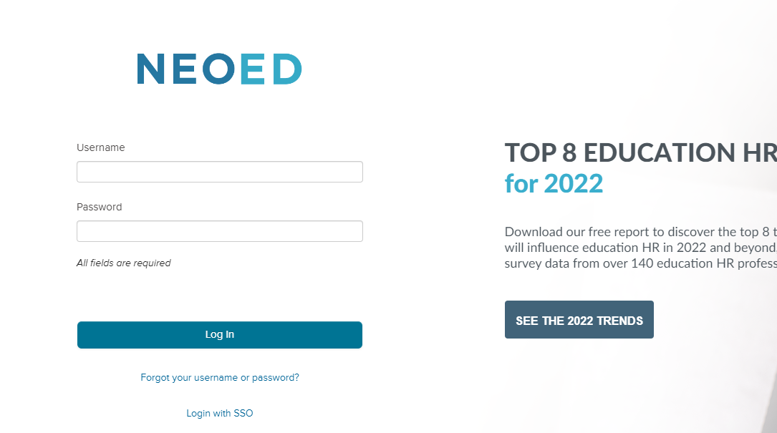
STEP 2 | Login To Your Account
The NEOED Onboard Portal can be accessed online at https://login.neoed.com
Use the email address and password you set for your account to login

Slide 6
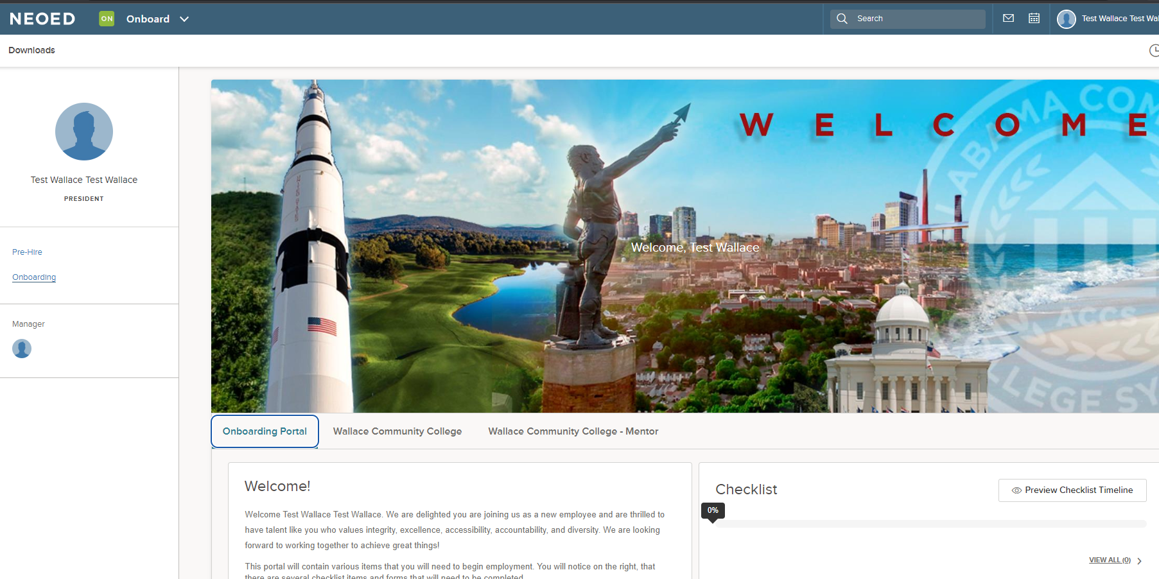
STEP 3 | View Your Onboarding Information
Onboarding Portal provides initial paperwork information
The Wallace Community College Portal provides information about:
Orientation
Wallace Community College
Benefits
Contact Information

Slide 7
STEP 4 | Complete Your Onboarding Checklist
Checklist is an interactive function on employee onboarding portal for new hires to provide required and optional onboarding information through the portal
Online Forms: Includes required forms (tax forms, direct deposit, etc.)
Document Upload: Employees can also upload I-9 documents
Click on form link in the checklist to submit information
Required forms must be completed within two (2) days of start date

Slide 8
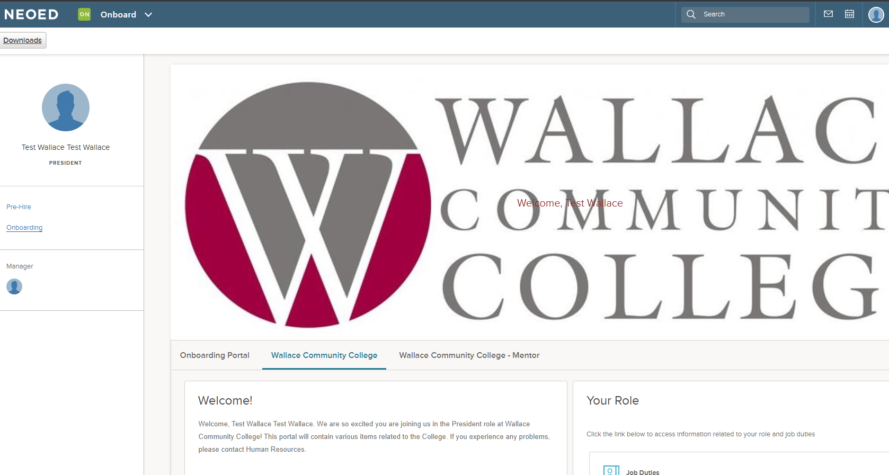
STEP 4 | Toggle to the Wallace Community College Portal
The Wallace Community College Portal provides information about:
Wallace Community College
Benefits
Contact Information

Slide 9
Questions?
Please contact the Human Resources office.
Email
humanresources@wallace.edu
Ms. Brooke Strickland
Director, Human Resources
334-556-2418
bstrickland@wallace.edu
Ms. Carrie Fodge
Human Resources Coordinator
334-556-2519
cfodge@wallace.edu
Ms. Katie Reese
Human Resources Assistant
334-556-2425
kreese@wallace.edu

